Slide 1
Introduction to React

Slide 2
What is React.js?
Developed by Facebook
React is a view layer library, not a framework like Backbone, Angular etc.
You can't use React to build a fully-functional web app

Slide 3
Why was React developed?
Complexity of two-way data binding
Bad UX from using "cascading updates" of DOM tree
A lot of data on a page changing over time
Complexity of Facebook's UI architecture
Shift from MVC mentality

Slide 4
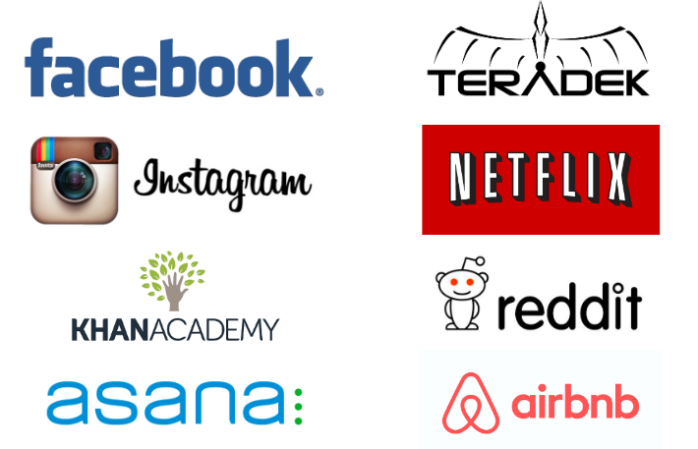
React Users

Slide 5
Benefits of React
Easy to understand what a component will render
Declarative code → predictable code
You don't really need to study JS in the view file in order to understand what the file does
Easy to mix HTML and JS
You do it already with template libraries (e.g. Handlebars, Mustache, Underscore etc.)
Uses full power of JS
Decoupling templates from logic does not rely on the templates’ primitive abstractions, but uses full power of JavaScript in displaying views

Slide 6
React is Fast!
Real DOM is slow
JavaScript is fast
Using virtual DOM objects enables fast batch updates to real DOM, with great productivity gains over frequent cascading updates of DOM tree
React Dev Tools
React Chrome extension makes debugging so much easier
No complex two-way data flow
Uses simple one-way reactive data flow
Easier to understand than two-way binding
Uses less code
Server-side rendering
React.renderToString() returns pure HTML

Slide 7
Complexity with React
React is nothing but the view
No events
No XHR
No data / models
No promises / deferreds
No idea how to add all of the above
Building JSX requires some extra work
But most of the work is already done for you by react-tools
No support for older browsers
React won't work with IE8
There some polyfills / shims that help

Slide 8
Why should I use React?
Easy to read and understand views
Concept of components is the future of web development
If your page uses a lot of fast updating data or real time data - React is the way to go
Once you and your team is over the React's learning curve, developing your app will become a lot faster

Slide 9
Is switching to React easy?
Understanding how it works will take time and will slow you down at first (but once you and your team get it, things will start happening much faster)

Slide 10
Component
Components are self-contained reusable building blocks of web application.
React components are basically just idempotent functions (same input produces same output).
They describe your UI at any point in time, just like a server-rendered app.
Created using React.createClass()
The only required method is render()
Inserted into DOM using React.renderComponent()

Slide 11
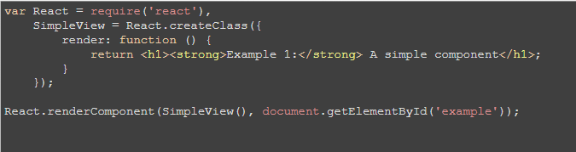

Slide 12
Types of Component
Functional Components:
Functional components are simply javascript functions.
We can create a functional component in React by writing a javascript function.
Class Components:
The class components are a little more complex than the functional components.
The functional components are not aware of the other components in your program whereas the class components can work with each other.
We can pass data from one class component to other class components.

Slide 13
Props
Props are arguments passed into React components.
Props are passed to components via HTML attributes.
React Props are like function arguments in JavaScript and attributes in HTML.
To send props into a component, use the same syntax as HTML attributes:
Ex. const myElement = <Car brand="Ford" />;

Slide 14
React Events
Just like HTML DOM events, React can perform actions based on user events.
React has the same events as HTML: click, change, mouseover etc.
Adding Events
React events are written in camelCase syntax:
onClick instead of onclick.
React event handlers are written inside curly braces:
onClick={shoot} instead of onClick="shoot()".

Slide 15
Handling Forms
Handling forms is about how you handle the data when it changes value or gets submitted.
In HTML, form data is usually handled by the DOM.
In React, form data is usually handled by the components.
When the data is handled by the components, all the data is stored in the component state.
You can control changes by adding event handlers in the onChange attribute.
We can use the useState Hook to keep track of each inputs value and provide a "single source of truth" for the entire application.

Slide 16
React Router
Create React App doesn't include page routing.
Add React router:
npm i -D react-router-dom

Slide 17
React Hooks
Hooks were added to React in version 16.8.
Hooks allow function components to have access to state and other React features.
Because of this, class components are generally no longer needed.
Hooks allow us to "hook" into React features such as state and lifecycle methods.

Slide 18
Task
Create One React Application and understand the uses of React Hooks
Use state hook
Use Effect hook
Use Context hook
Use Location hook

Slide 19
Consuming the Data from RESTful API
You can consume the data from Restful api to your React application
Ways to consume the webservices:
Fetch API
AXIOS

Slide 20
AXIOS
Axios is a promise-based HTTP Client for node.js and the browser.
It is isomorphic (= it can run in the browser and nodejs with the same codebase).
On the server-side it uses the native node.js http module, while on the client (browser) it uses XMLHttpRequests.
Installation:
Npm install axios

Slide 21
Let’s try to work with AXIOS
Get
POST
PUT
DELETE

